Slide 1



Superstore sales data Analysis
View in Power BI
Last data refresh:
5/16/2025 1:14:25 PM UTC
Downloaded at:
6/10/2025 11:06:16 AM UTC

Slide 2
Overview
In this project, we will create a mini-project on the “Super Store Sales” data set.
Situation
Global Super Store is an online supergiant store that has worldwide operations. This store takes orders and delivers products across the globe and deals with all the major product categories like furniture, office supplies and technology, and so on.
As a Sales Manager of this store, you want to analyze the sales of the products based on provided historical data, this analysis will help you to plan your inventory and business processes accordingly. Also, to know the products and customer’s behavior.

Slide 3
Tasks
1. Load data from the provided data sources (excel workbooks).
2. Perform the required data transformations in the Power Query Editor window.
3. Create the relationships between the loaded tables.
4. Create the required measures for key performance indicators like Sales, Profit, and Ratio.
5. Use the visuals as per the provided design to plot dimensions like Category, Year, Region, Market,
Sub-category, Manager, and so on. Add key slicers to slice and dice data in the visuals.
6. Train the Q&A data model for the below synonyms:
Revenue: Sales
Income: Profit
Income Percentage: Profit Ratio
7. Managers should have restricted data access as per their market allocation by the organization.
(Implement RLS)
8. Publish a report in the Power BI Service and share it with other users of the same market role.

Slide 4
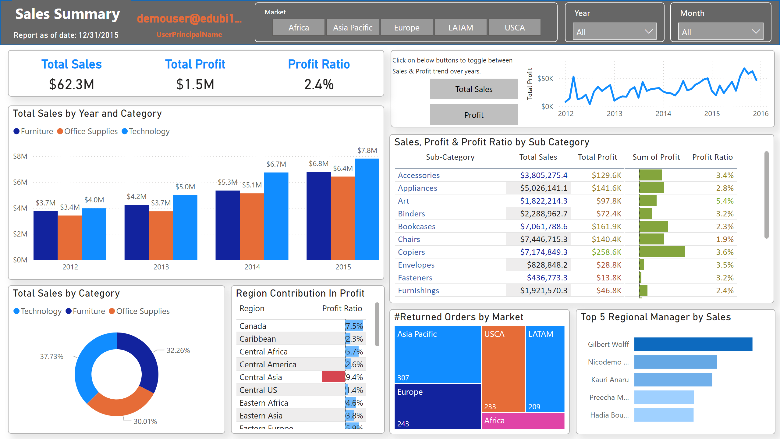
Sales Summary
Notes:
shape
No alt text provided
textbox
No alt text provided
card
No alt text provided
slicer
No alt text provided
slicer
No alt text provided
slicer
No alt text provided
clusteredColumnChart
No alt text provided
donutChart
No alt text provided
Region Contribution In Profit
No alt text provided
shape
No alt text provided
textbox
No alt text provided
Sales, Profit & Profit Ratio by Sub Category
No alt text provided
#Returned Orders by Market
No alt text provided
Top 5 Regional Manager by Sales
No alt text provided
card
No alt text provided
cardVisual
No alt text provided
lineChart
No alt text provided
lineChart
No alt text provided
actionButton
No alt text provided
actionButton
No alt text provided

Slide 5
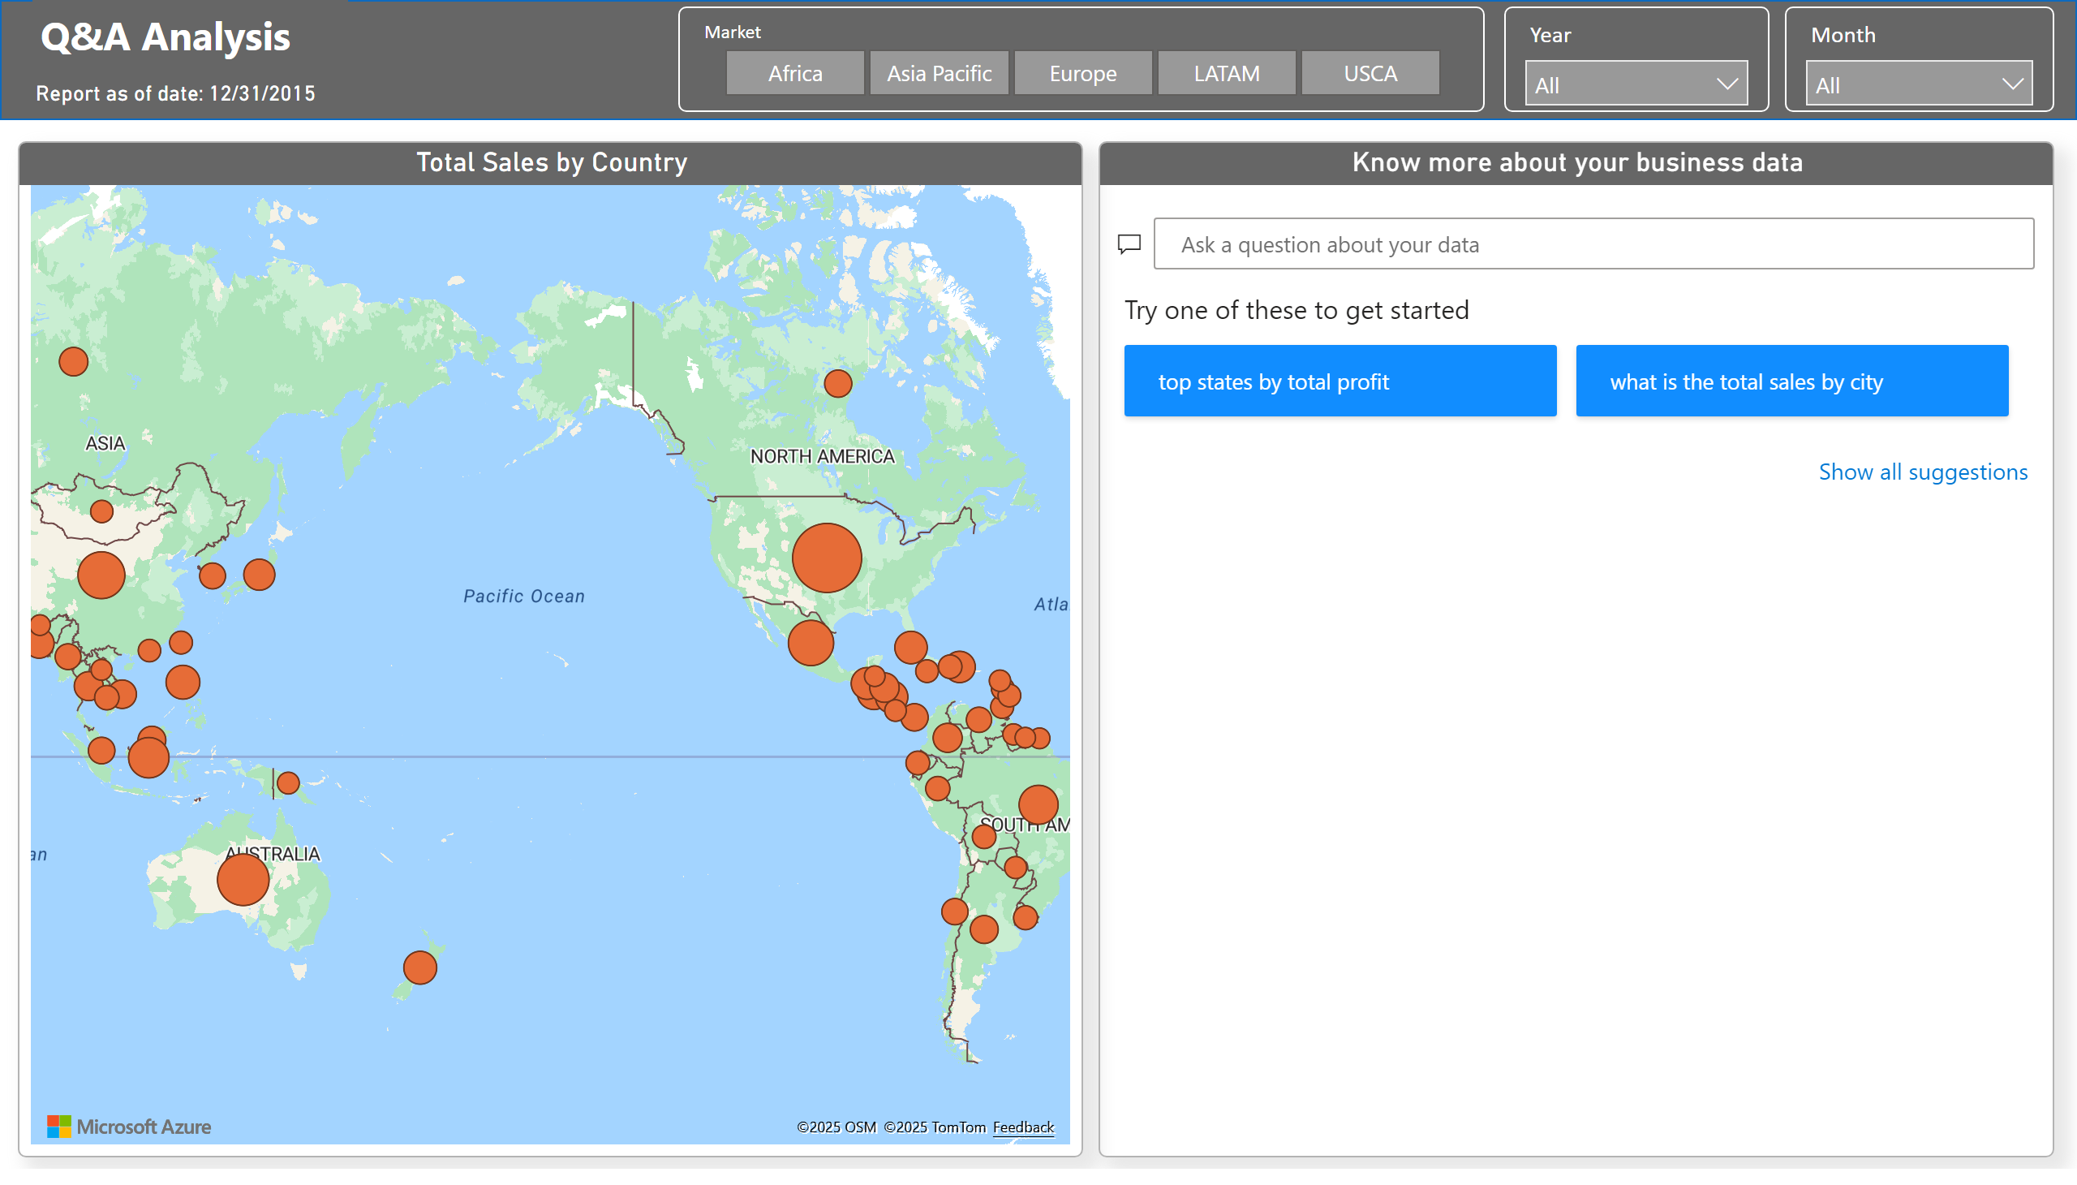
Q&A Analysis
Notes:
slicer
No alt text provided
slicer
No alt text provided
slicer
No alt text provided
Know more about your business data
No alt text provided
azureMap
No alt text provided
card
No alt text provided
textbox
No alt text provided
shape
No alt text provided

